Slide 1
Virtual Job Fair v6.0
Product Owners
Fernando Figueredo, Ph.D., APR.
Emmanuela Stanislaus, M.Sc.
Ivette Duarte, M.S.
Professor and Mentor
Masoud Sadjadi, Ph.D. FIU
Students
Rene Alfonso
Developer, Tester and Scrum Master
Yanniel J. Malagon
Developer, Tester
Notes:
Hello and welcome to the Introduction Video of Virtual Job Fair
Thank you for attending our final presentation.
My name is Yanniel Malagon and I will be presenting Virtual job Fair version 6.0
And for the Summer 2015, I was the a developer and tester of Virtual Job Fair. My team member Rene Alfonzo was a developer, tester and Scrum master.
Virtual Job Fair is a web system that provide student with thousands of job visibility, and employer with the opportunity to tap talent at universities.

Slide 2
Acknowledgment
VJF 1.0 (Spring 2013)
Justin Korah, Diego Perez, Andres Gonzalez, Enmanuel Corvo and Tomer Doar
Luis Irizarry, Luis Benjumea and Jorge Fernandez
VJF 2.0 (Fall 2013)
VJF 3.0 (Summer 2014)
Ana L. Hernandez, Manuel Bouza, Enio Peña Navarro and Tomas Acosta
Erick Arenas, Artiom Tiurim
VJF 4.0 (Fall 2014)
VJF 5.0 (Spring 2015)
Rogelio Alonso
Notes:
I would like to start by acknowledging my fellow classmates from previous semesters for their contribution and hard work on the project.

Slide 3
Problem Definition
Employer:
Expensive (Job Fairs and Recruiting)
Limited Selection
No Financial Resources
Students:
No Means or time
Cannot show their skills, experience and talent via through emails
Notes:
There are two main issues that make the hiring process difficult for students and employers. First, it is very expensive for employers to participate in Job Fairs or recruit student from different universities. Also, they do not have a wide range of selection nor the financial resources to find the perfect candidate for the job. Secondly, many students do not have the means or time to meet with potential employers in person. In addition, most students cannot show their skills, experience and talent to employers through emails.
Consequently, they might lose great job opportunities. Virtual Job Fair is designed to solve these issues. Having Virtual Job Fair application is a win-win opportunity for both the student and employer.

Slide 4
Current System Limitations
Version 5.0 does not do any of the following:
Support YouTube Video Resume
Restore deleted messages
List Applied Jobs
Display active mailbox container
Clone Job Posts
Display number of unread messages
Recipients Address String Validation
Job Application Button
Allow Multiple Admin Accounts
Add Cover Letter
Guest Account Secure Access
Profile Completion Graph
LinkedIn login and profile information retrieval with OAuth2.
Add multiple recipients using the autocomplete
Notes:
Version 5.0 had the following limitations:

Slide 5
System Limitations (Cont.)
Version 5.0 does not do the following:
Cleanup User Data after Admin Deletes User
Display Candidate List Video Resumes
Allow Disable & Enable Users as Admin
Handle Expired Job Post Exceptions
Display correct date and time in messages
Remove expired jobs from available job listing
Display job description in clear text format
Google Login profile creation
Add skills with special characters
Uploading Profile Picture file type verification
Unable to reply messages correctly
Display Confirmation Message after Password Change

Slide 6
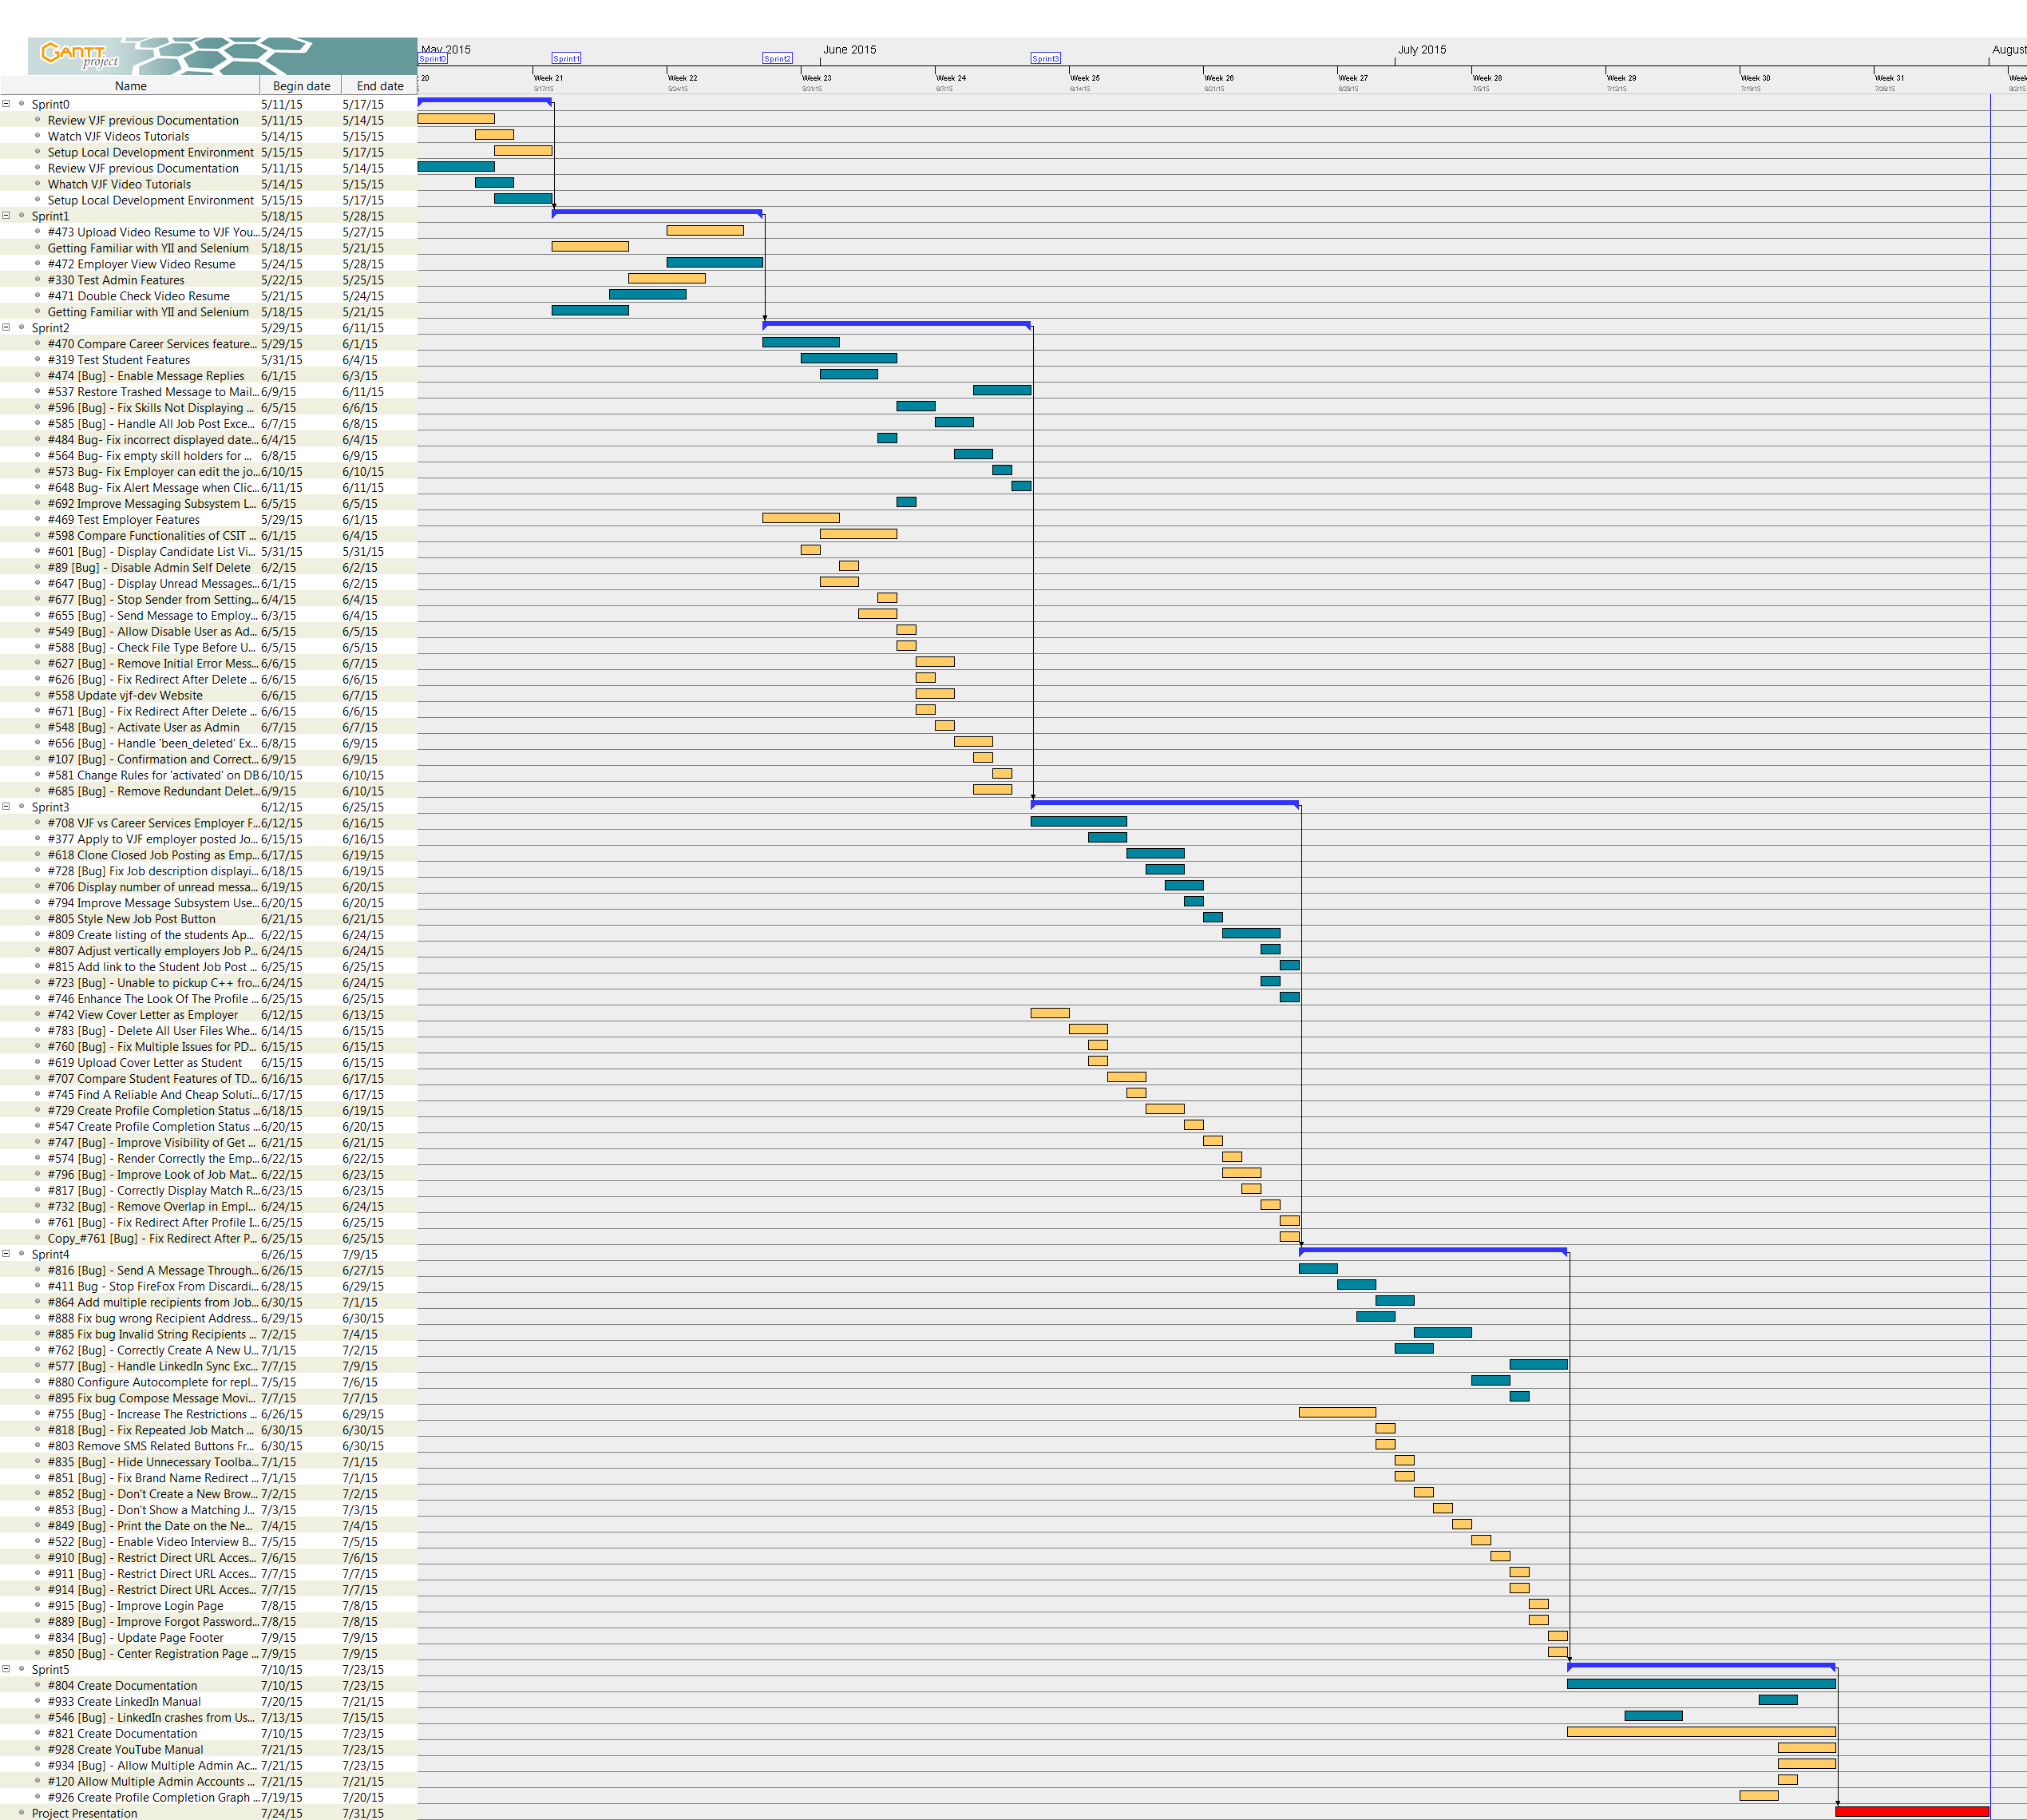
Gantt Chart
Notes:
This is the completed Gantt chart for the semester, here we have listed all the users stories we have worked on.
We the a Scrum divide in 5 Sprints

Slide 7
Main User Stories
Upload Video Resume to VJF YouTube Channel
Restore Trashed Message to Mailbox
Test Student Features
Test Employer Features
Test Admin Features
Create Profile Completion Graph
View Cover Letter as Employer
Upload Cover Letter as Student
Create listing of the students Applied Jobs
Test the Replace PDF and Video Resume.
Clone Closed Job Posting as Employer
Increase The Restrictions of Guest Accounts
Notes:
On the first sprint I enable two new actors to the system, the guest Employer and Guest Student and gave them limited functionality.
I also tested the Student/employer actor user stories and created and automated test script that can be used in regression testing.
Allowed the Student to replace Video and PDF resume files.
Created a feasibility study for a search engine
And, in the last sprint Installed and configured Solr search engine and created an schema to index MySQL tables.

Slide 8
Stability Fixes
Enable Message Replies
Fix Skills Not Displaying Correct Characters
Display Candidate List Video Resumes
Disable Admin Self Delete
Display Unread Messages Notifications on Home Page
Send Message to Employer as Admin
Handle All Job Post Exceptions
Change Password.
Fix empty skill holders for matched jobs
Fix Skills Not Displaying Correct Characters
Delete All User Files When Admin Deletes User
Fix Job description displaying unwanted HTML tags
Send A Message Through Job Match Page
Stop Firefox From Discarding Blank Email Alerts
Handle LinkedIn Sync Exception
Fix Repeated Job Match Notifications

Slide 9
Main User Stories
Number of bugs fixed during new system release: 53
Number of new features added: 10
Notes:
On the first sprint I enable two new actors to the system, the guest Employer and Guest Student and gave them limited functionality.
I also tested the Student/employer actor user stories and created and automated test script that can be used in regression testing.
Allowed the Student to replace Video and PDF resume files.
Created a feasibility study for a search engine
And, in the last sprint Installed and configured Solr search engine and created an schema to index MySQL tables.

Slide 10
Use Case for YouTube Video Resume Upload
Use Case ID | #473 Upload Video Resume to VJF YouTube Channel
Description | Allows student upload video resume.
User Story #473 | As student, I should be able to upload my Video Resume into the system so that the potential employer can access my video resume.
Actor | Student
Pre-conditions | Actor is logged in. Actor is in his/her profile page. Actor has a video resume to upload to the system.
Steps | Use case begins when the actor clicks on the upload resume button. System displays a windows to select the file to be uploaded. Actor selects his/her resume file from the computer and click open. System uploads the video resume to YouTube and save video URL to the database. YouTube video player Iframe is displayed on the user profile.
Post-conditions | Actor upload his/her video resume file.
Alternative Steps | From step 4 the file cannot be uploaded or the URL inserted in the database. System displays the upload had an error.
Exceptions | Invalid file format. Invalid file extension. No file selected

Slide 11
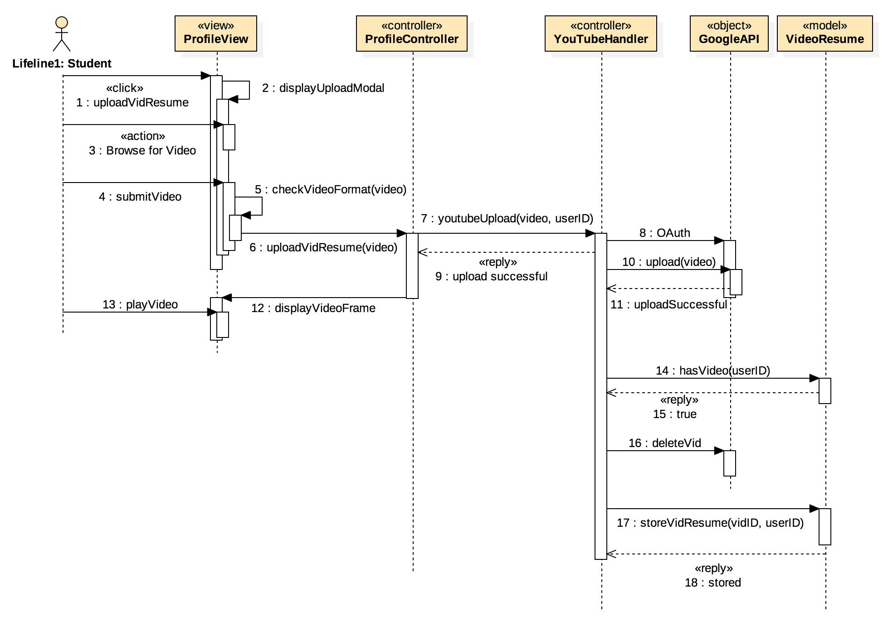
Video Resume Upload Sequence Diagram

Slide 12
Use Case for Apply for Job
Use Case ID | #377 Apply to VJF employer posted Jobs
Description | Allows students to see a list of all jobs they have applied in the past.
User Story #809 | As student, I would like to have a history of the jobs that I have applied for, so I can follow up the status and information about previous job applications.
Actor | Student
Pre-conditions | Actor is logged in. Actor is a job post page. Actor needs to apply to a job in the system.
Steps | Use case begins when the actor clicks on a job post. Then he/she clicks on the Apply button of a non-expired job post. System process the job application. A message is displayed to the user indicating the status of the application. Actor click the home page button.
Post-conditions | System display the job applied under the “Jobs Applied” widget of the actor home page.
Alternative Steps | On step #1 user clicks a job the he/she already applied for from the job search page.
Exceptions | The system show a message to user saying “You have already applied for this job.”

Slide 13
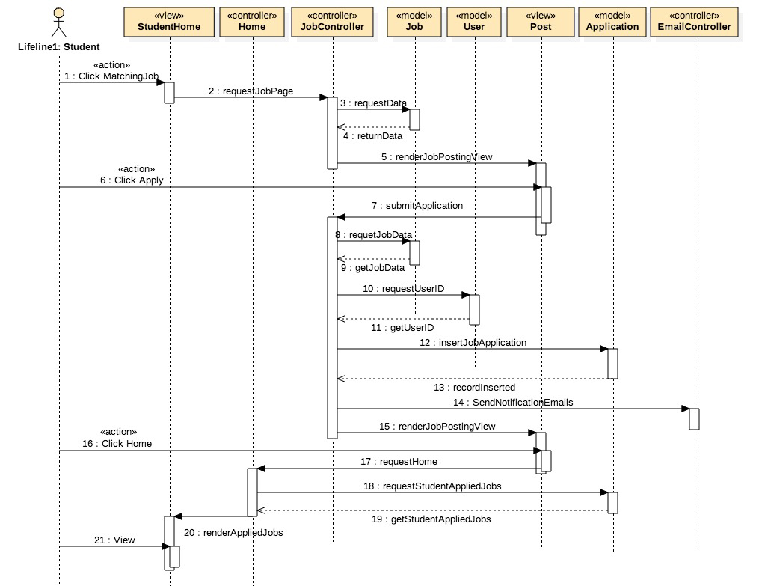
Apply for Job Sequence Diagram

Slide 14


System Architecture
Yii Router
1-HTTP Request
7-HTML
2-Action
5-Invoke
3-Call
View
Controller
Model
6-HTML
4-Send Content

Slide 15
System Decomposition
Job Subsystem
User Subsystem
API Subsystem
Alternative Logins Subsystem
YouTube Subsystem
Collaboration Tools
Skills Subsystem
Notification Subsystem
Solr Subsystem
Message subsystem
Site Subsystem
E-mail Message Subsystem

Slide 16
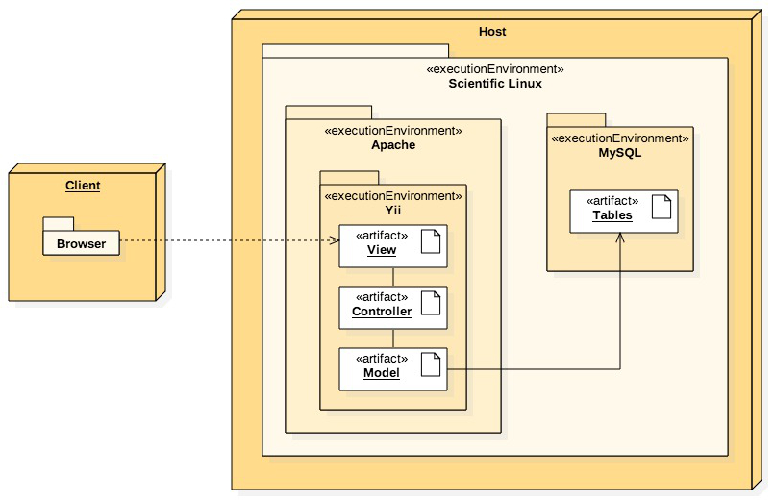
System Deployment

Slide 17

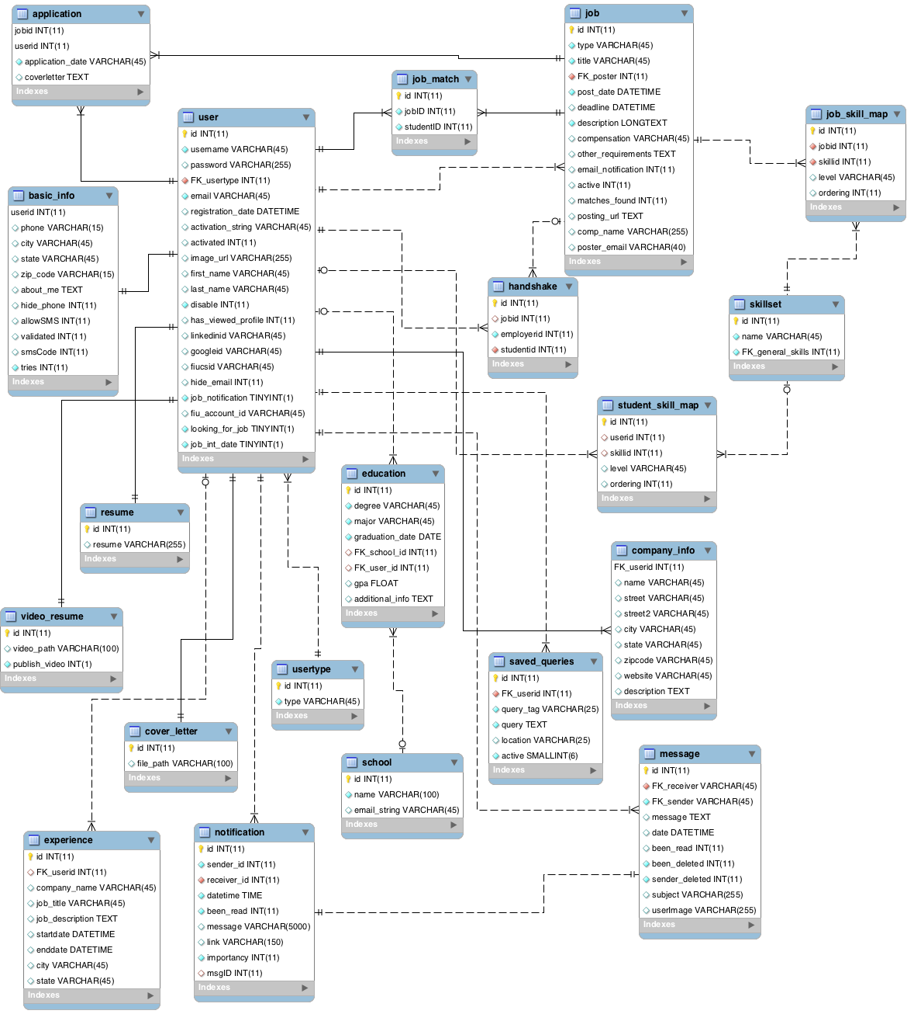
Persistent Data

Slide 18
Security and Privacy
Restrict direct URL access
‘www.vjf.cs.fiu.edu/JobFair/index.php/employerhome’
Stop Admin self delete
Guest account restrictions
Disable expired jobs

Slide 19
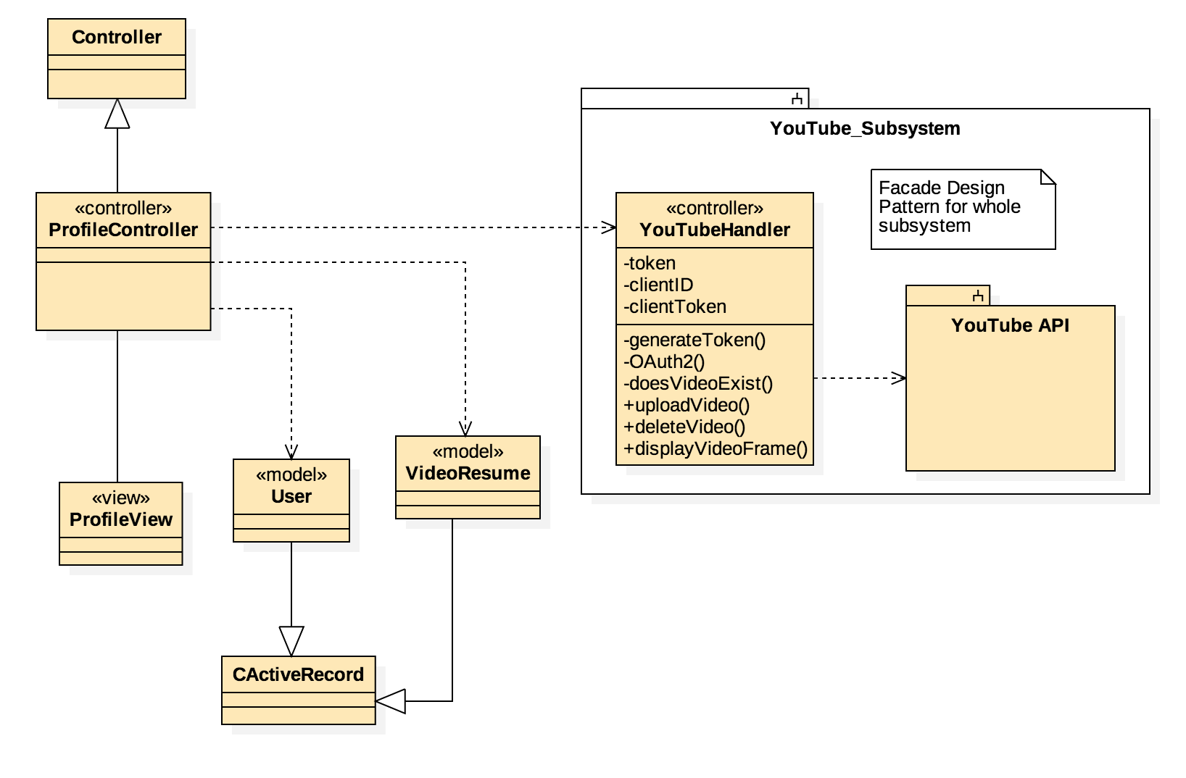
Class Diagram for YouTube Video Resume Upload

Slide 20
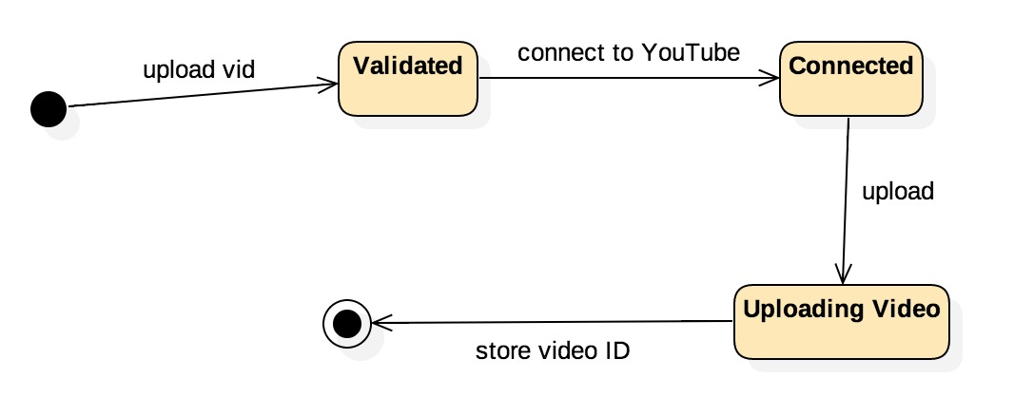
State Diagram for YouTube Video Resume Upload

Slide 21
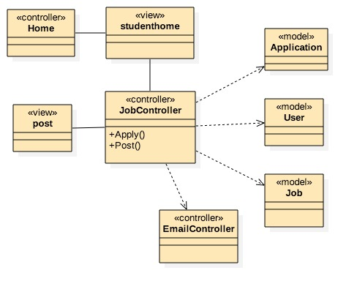
Class Diagram for Apply Job

Slide 22
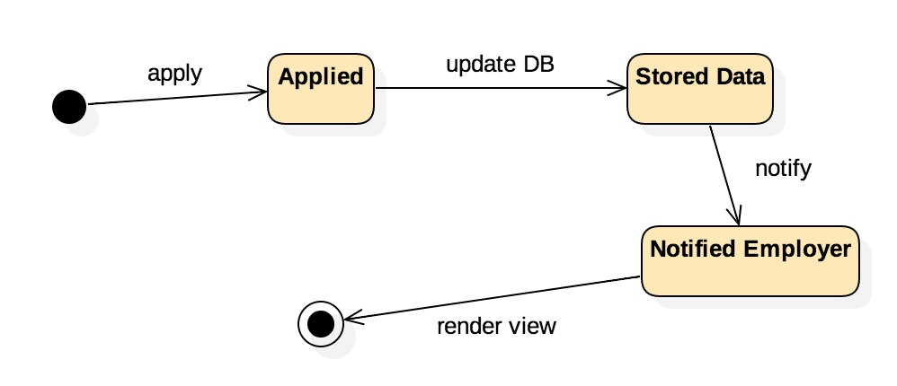
State Diagram for Apply Job

Slide 23
Algorithm used to Upload Video Resume
JavaScript File Verification (Client Side)
Authenticate with YouTube
Upload the video to YouTube
Delete Previous Resume (if any)
Update the Model

Slide 24
Algorithm used for Apply Job
Check if job has expired
Allow application
Update Model
Send Notifications

Slide 25
Test Cases for uploading YouTube Video Resume:
Sunny Day Test Case
Rainy Day Test Case
Test Case ID | S0011- Video Resume Upload
Purpose | To validate use case #473 Upload Video Resume to VJF YouTube Channel, with a valid Video Resume file and format.
Preconditions | User is in his/her profile page
Inputs(s) | User presses Upload Video Resume button. User select a video resume file from his/her PC with a valid file. extension User clicks Select button.
Expected Result | System displays a YouTube video Iframe player in the user profile page.
Test Case ID | S0014 - Invalid Video Format
Purpose | To validate use case #473 Upload Video Resume to VJF YouTube Channel, with an invalid Video Resume file and format.
Preconditions | User is in his/her profile page
Inputs(s) | User presses Upload Video Resume button. User select a file from his/her PC with an invalid file extension. User clicks Select button.
Expected Result | System displays “You need to specify a valid file.”

Slide 26
Test Cases for Apply Job
Sunny Day Test Case
Rainy Day Test Case
Test Case ID | S0033 - List Applied Job Post
Purpose | To validate use case #809 Create listing of the students Applied Jobs with a valid job post.
Preconditions | User is in his/her profile page
Inputs(s) | User presses a job post link from the student home or the job search page. User presses the apply button in the job post page. User clicks the home page.
Expected Result | System the job the user applied should be listed in the Jobs Applied widget.
Test Case ID | S0030 - Open Expired Matched Job Posting
Purpose | To validate use case #809 Create listing of the students Applied Jobs with a non-expired job post.
Preconditions | User is in his/her profile page
Inputs(s) | 1. User presses a job post link from the student home or the job search page.
Expected Result | System displays message “This Job has expired. Please select another Job.”

Slide 27
Admin Test Suites Features
A000 LoginRainyDay
A001 Login-Logout
A002 Login
A003 AddStudent
A004 AddDuplicateStudent
A005 RemoveUser
A006 AddEmployer
A007 CheckStatistics
A008 AddSkill
A009 AddDuplicateSkill
A010 MergeSkills
A011 MergeSkillsRainy
A012 ViewMessages
A013 SendMessage
A014 ReadMessage
A015 Settings
A016 ImportJobs
A017 SearchPosting
A018 SearchPostingTitle
A019 DeletePosting
A020 Update-DeleteUser
A021 DeleteAdmin
A022 Disable-ActivateUser
A023 SendMsgToEmployer
Total Test Cases: 24

Slide 28
Student Test Suites Features
S0001 – Login
S0002 – Logout
S0003 – Registration
S0003 - Registration
S0004 - Validation
S0005 - View Profile
S0006 - Add Education
S0007 - Remove Education
S0008 - Start Video Interview
S0009 - Share Screen on ScreenShare
S0010 - Show Whiteboard
S0011- Video Resume Upload
S0012 - Publish Video Resume
S0013 - Unpublished Video Resume
S0014 - Invalid Video Format
S0015 - Send Message
S0016 - Upload PDF Resume
S0017 - View PDF Resume
S0018 - Search Jobs
S0019 - Save Search Jobs Queries
S0020 - Delete Saved Job Search Query

Slide 29
Student Test Suites Features (Cont.)
S0021 - Add Skills
S0022 - Remove Skill from Student Profile
S0023 - View Miscellaneous Activities
S0024- View Matching Job Listing
S0025 - Open a Matching Job Posted
S0026 - Upload Profile Image
S0027 - Change Profile Image
S0028 - Add Experience
S0029 - Remove Experience
S0030 - Open Expired Matched Job Posting
S0031 - Job Search-Save-Delete
S0032 - Restore Deleted Message
S0033- List Applied Job Post
Total Test Cases: 33

Slide 30
Employer Test Suites Features:
E000 LoginRainyDay
E003 ViewProfile
E004 ChangePicRainy
E005 ChangePic
E006 ViewJobPosting
E007 EditJobPosting
E008 OpenStudentProfile
E009 ViewVidResume
E010 ViewSkills
E011 ViewProfilePic
E012 ViewMessages
E013 SendMessage
E014 ReadMessage
E015 CreateVidInterview
E016 SearchStudentBySkill
E017 AdvanceStudentSearch
E018 NewJobPosting
E0019 Clone Job Posting
E0020 ChangePassword
E0021 CandidateVidResume
E0022 Notifications
E0023 Save-Delete-EmpQuery
Total Test Cases: 22

Slide 31
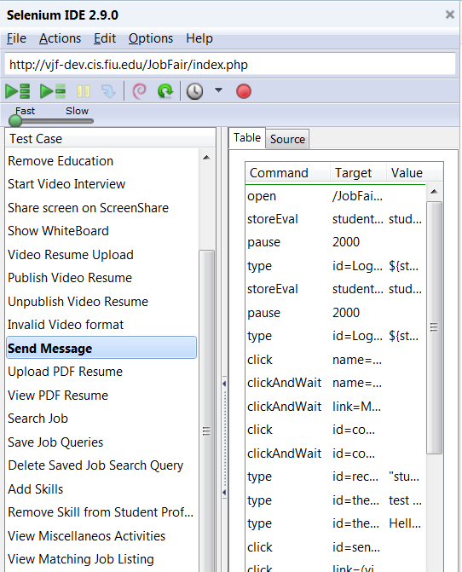

Automated Test Suite

Slide 32
Thank you for listening…

